Slide 1
Importing and Exporting Data

Slide 2
Importing Data

Slide 3
Importing Data
Importing data into Simulink allows you to take data from the Matlab workspace and then use it in the Simulink environment
This is accomplished using one of two methods

Slide 4
Importing Data
The first method is straight forward
In most places that you can type in a number, you can replace the number with a variable name
If that variable name is declared in the Matlab workspace, the value that it contains will be used

Slide 5
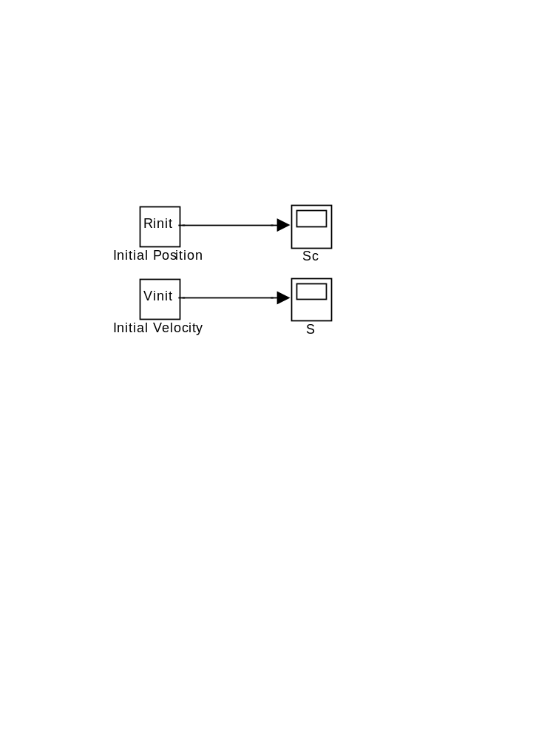
Importing Data
For example, in our integration project, we could have replaced the numbers in the constant block with variable names that pointed to vectors in the Matlab workspace.
Workspace Simulink
Rinit = [1;2]
Vinit = [3;4]

Slide 6
Importing Data
The second method is the “From Workspace” block
The “From Workspace” block is not as straightforward as it might initially appear
In addition to importing values from the workspace, each value must have an associated time that the value becomes effective

Slide 7
Importing Data
Example:
There will be two arrays that we have to pass into Simulink
One is a time array and the second is the list of values we want to transfer
>> t=[0;1]
>> x=[5;10]

Slide 8
Importing Data
>> t=[0;1]
>> x=[5;10]
Here, inside Simulink ‘x’ will have a value of 5 at time 0 and ‘x’ will have a value of 10 at time 1

Slide 9
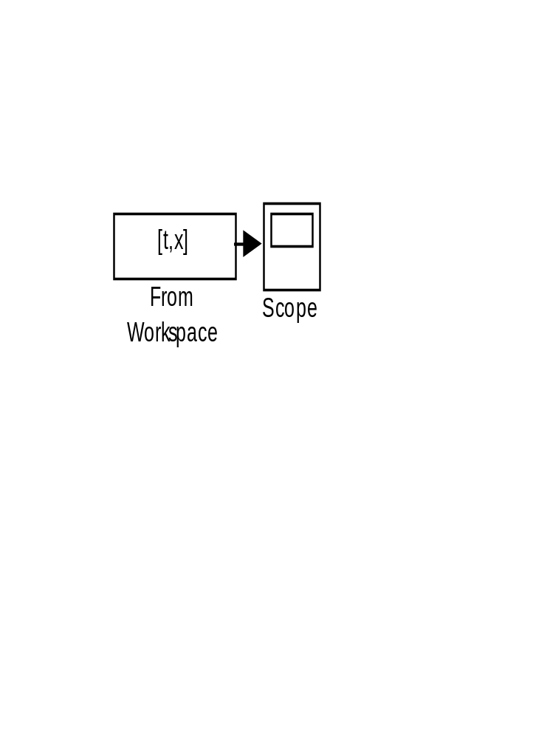
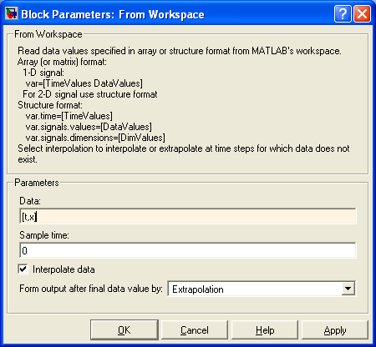
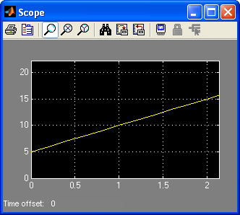
Importing Data
In Simulink x has a value of 5 at time 0 and a value of 10 at time 1. (Interpolate and Extrapolation are turned on in the “From Workspace” block.
[t,x]

Slide 10
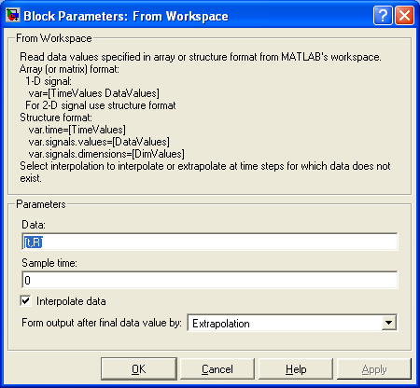
Importing a Vector
To import a time varying vector, define the time and the vector arrays
>> t=[0;5]
>> R=[1,2,3;4,5,6]
And inside the “From Workspace” block use the following line [t,R]
[t,R]

Slide 11
Exporting Data

Slide 12
Exporting Data
Often it is nice to export data from Simulink to do additional analysis or to generate reports
There are two common methods:
  export to a Matlab variable
  copy a plot to paste in another application

Slide 13
Exporting to Matlab Variable
In the sinks box select the “To Workspace” box
Double click on it and set the variable name
Select Save Format as “Array”
Feed a signal into it
Run the Simulink program
The data is now in the variable in Matlab

Slide 14
Exporting to Matlab Variable
Hints:
  “tout” is a time array variable that simulink automatically puts in the workspace
  “who” is a command in Matlab that lists all of the variables in the workspace
  the data can be cut and pasted into other applications by going to the “Workspace” window and double-clicking on the variable

Slide 15
Exporting a Plot
To copy a plot to another application
Highlight the window with the plot
Type Alt-PrintScreen
Now that window is on the clipboard and it can be pasted in another document

